Slide 1
Pesticides
NPDWAG Comms Update
October 2021

Slide 2
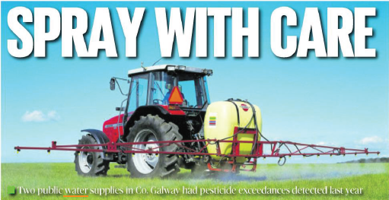
Media Engagement (July – October)
40 pieces of coverage
17 regional radio pieces
8 online pieces
10 regional print
5 national across print and online
Prime positive
Images were used
Key messages were carried
Hugely positive campaign building trust and confidence in IW and the NPDWAG
Spokespeople delivered positive sentiment

Slide 3
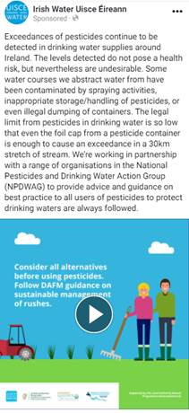
Autumn Facebook Campaign
Facebook Dark Posts 1st September – 1st October
Targeted campaign in priority areas (64 areas) with consistent message and look and feel to DoneDeal and Agriland.ie ads
Campaign Stats
140,261 impressions
133,696 reach
10,274 video views
29 likes
5 comments
6 shares

Slide 4
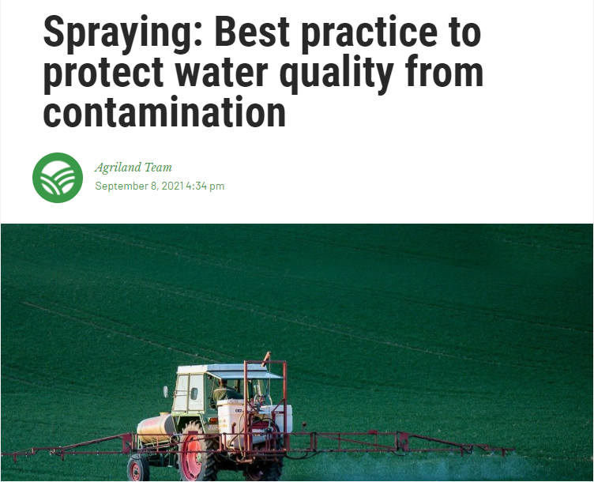
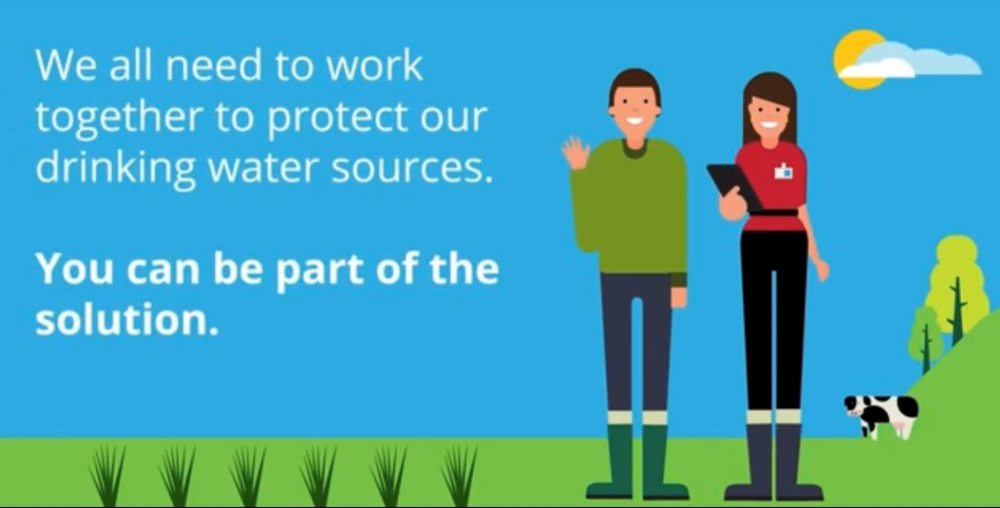
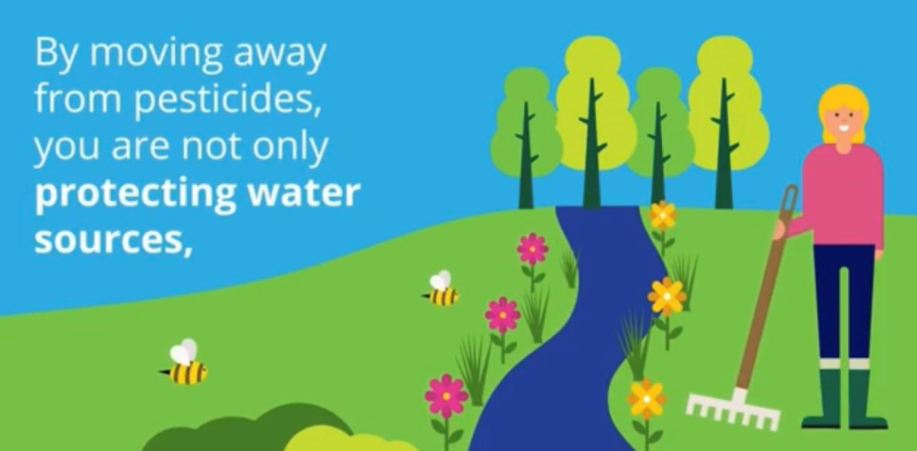
Agriland Native Article
Benefits
7 days live across the Agriland site so 300,000+ weekly users can read them.
Article also went out through their Facebook, Twitter & LinkedIn to our 240,000 Social Media followers.
Articles presented in our preferred sections (e.g. Tillage etc.), to ensure enhanced targeting to the relevant audience.
Agriland Campaign Results
Total Reads : 906
Average Read Time : 2 Minutes 4 Seconds

Slide 5
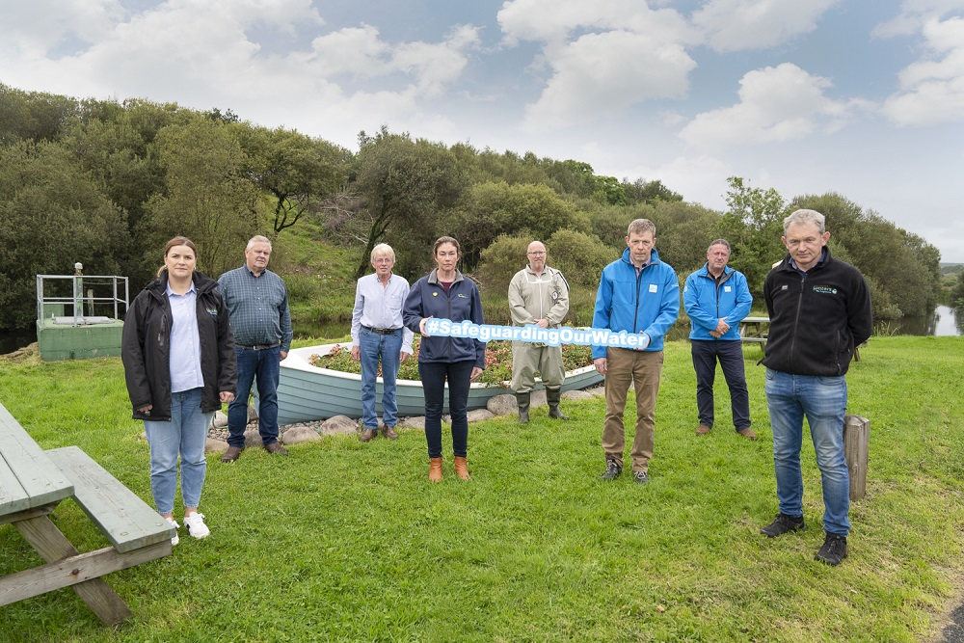
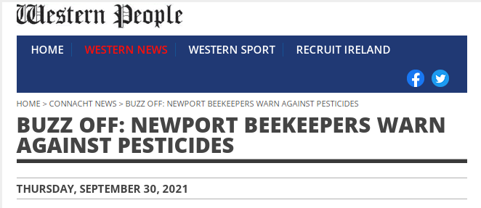
Let it Bee: Newport beekeepers
With the support of Irish Water, Mayo County Council, The National Federation of Group Water Schemes (NFGWS) and The Local Authority Waters Programme (LAWPRO) the beekeepers are looking after hives at Newport Water Treatment Plant.
Press release issued (national and regional)
Elected Representative Update
Website updated
Social media channels updates

Slide 6
Additional Proactive Communications
Providing quarterly updates to the EPA on our recent communications in relation to pesticides
(name redacted) (Irish Water) panellist on a Source to Tap webinar on Rush Control on 29 September

Slide 7
Thank you for your time
press@water.ie
@IrishWater
@IWCare
1800 278 278 customer care 24/7

