Slide 1
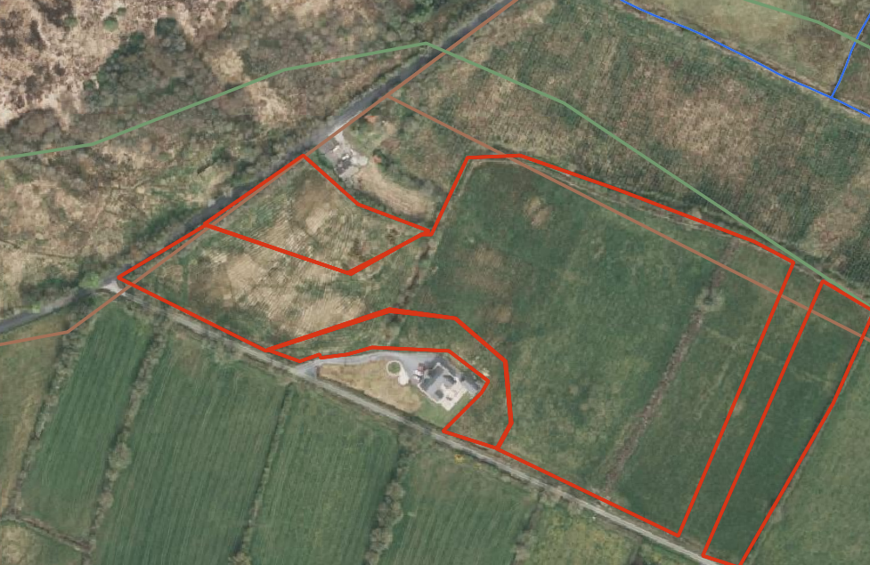
Group 1 – starts at HNV (30 mins), then birds (15 mins), then soil (15 mins)
Group 2 – Starts at birds (15), then soil (15)
Group 2 and 3 go to HNV together (30 mins)
Group 3 – starts at soil (15), then birds (15)
Soil
Birds
HNV

Slide 2
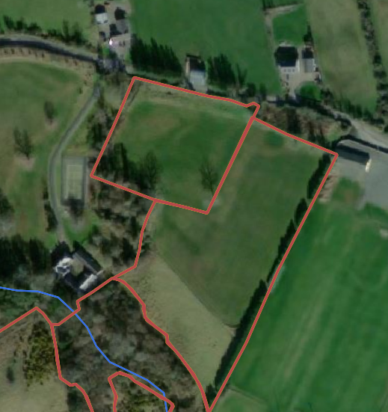
Group 1 – starts at HNV (30 mins), then birds (15 mins), then soil (15 mins)
Group 2 – Starts at birds (15), then soil (15)
Group 2 and 3 go to HNV together (30 mins)
Group 3 – starts at soil (15), then birds (15)
HNV
Soil
Birds

