Slide 1
High Nature Value Farmland (HNVF) Procedures
Forest Service, DAFM
02/10/2023

Slide 2

High Nature Value Farmland (HNVF)
Matin et al (2020) identified five likelihood categories of HNVf in Ireland and mapped their distribution. The indicative HNVf map (Matin et al., 2020) will be incorporated into iFORIS and iNET. Where applications are within an area identified as having a value of 0.5 SD HNVf likelihood on the High Nature value farmland likelihood map then the applicant is required to provide additional information. A habitat survey will be required identifying the habitat classification according to Fossit (2000), a species survey as per R+N scoring and the links/potential links to Annex I habitat (the latter recognising that some habitats may have species representative of Annex I habitats but due to structure/threats are not Annex I). The application will be also assessed against the semi-natural grassland layer (publicly available from NPWS) and the Birdwatch Ireland Farmland Bird Hotspot map. Based on consideration of evidence of the presence of HNV farmland and other relevant information, decisions on afforestation projects will avoid negative effects on HNV farmland, including cumulative negative effects at landscape level.”
An Roinn Talmhaíochta, Bia agus Mara │ Department of Agriculture, Food and the Marine

Slide 3
Summary
Matin et al. (2020) – 5 likely categories
indicative HNVf map
> 0.5 SD HNVf likelihood on the High Nature value farmland likelihood map
Habitat Survey
Species Survey
Irish Semi-Natural Grassland Layer
BWI Farmland Bird Hotspot

Slide 4
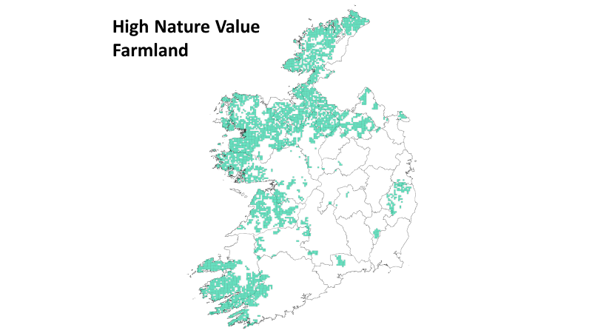

Slide 5
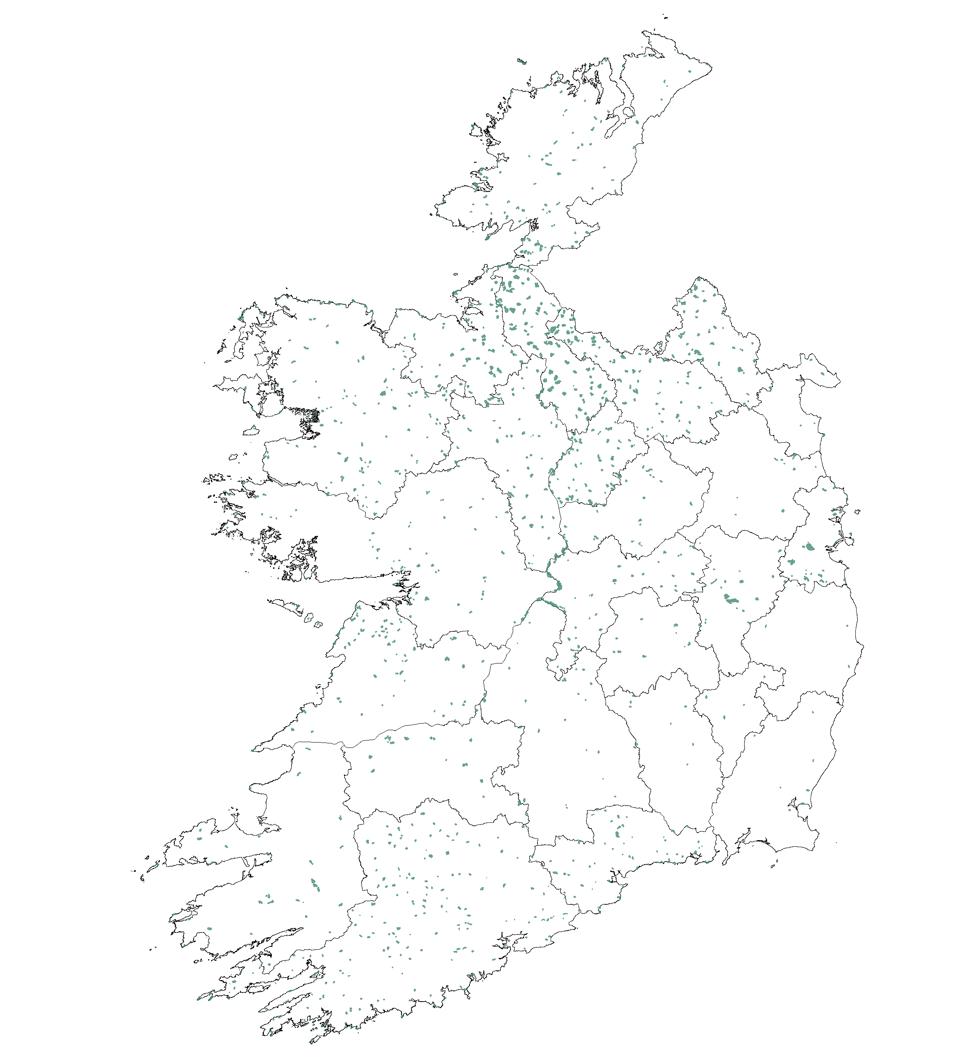
Irish Grassland
Habitats Survey

Slide 6
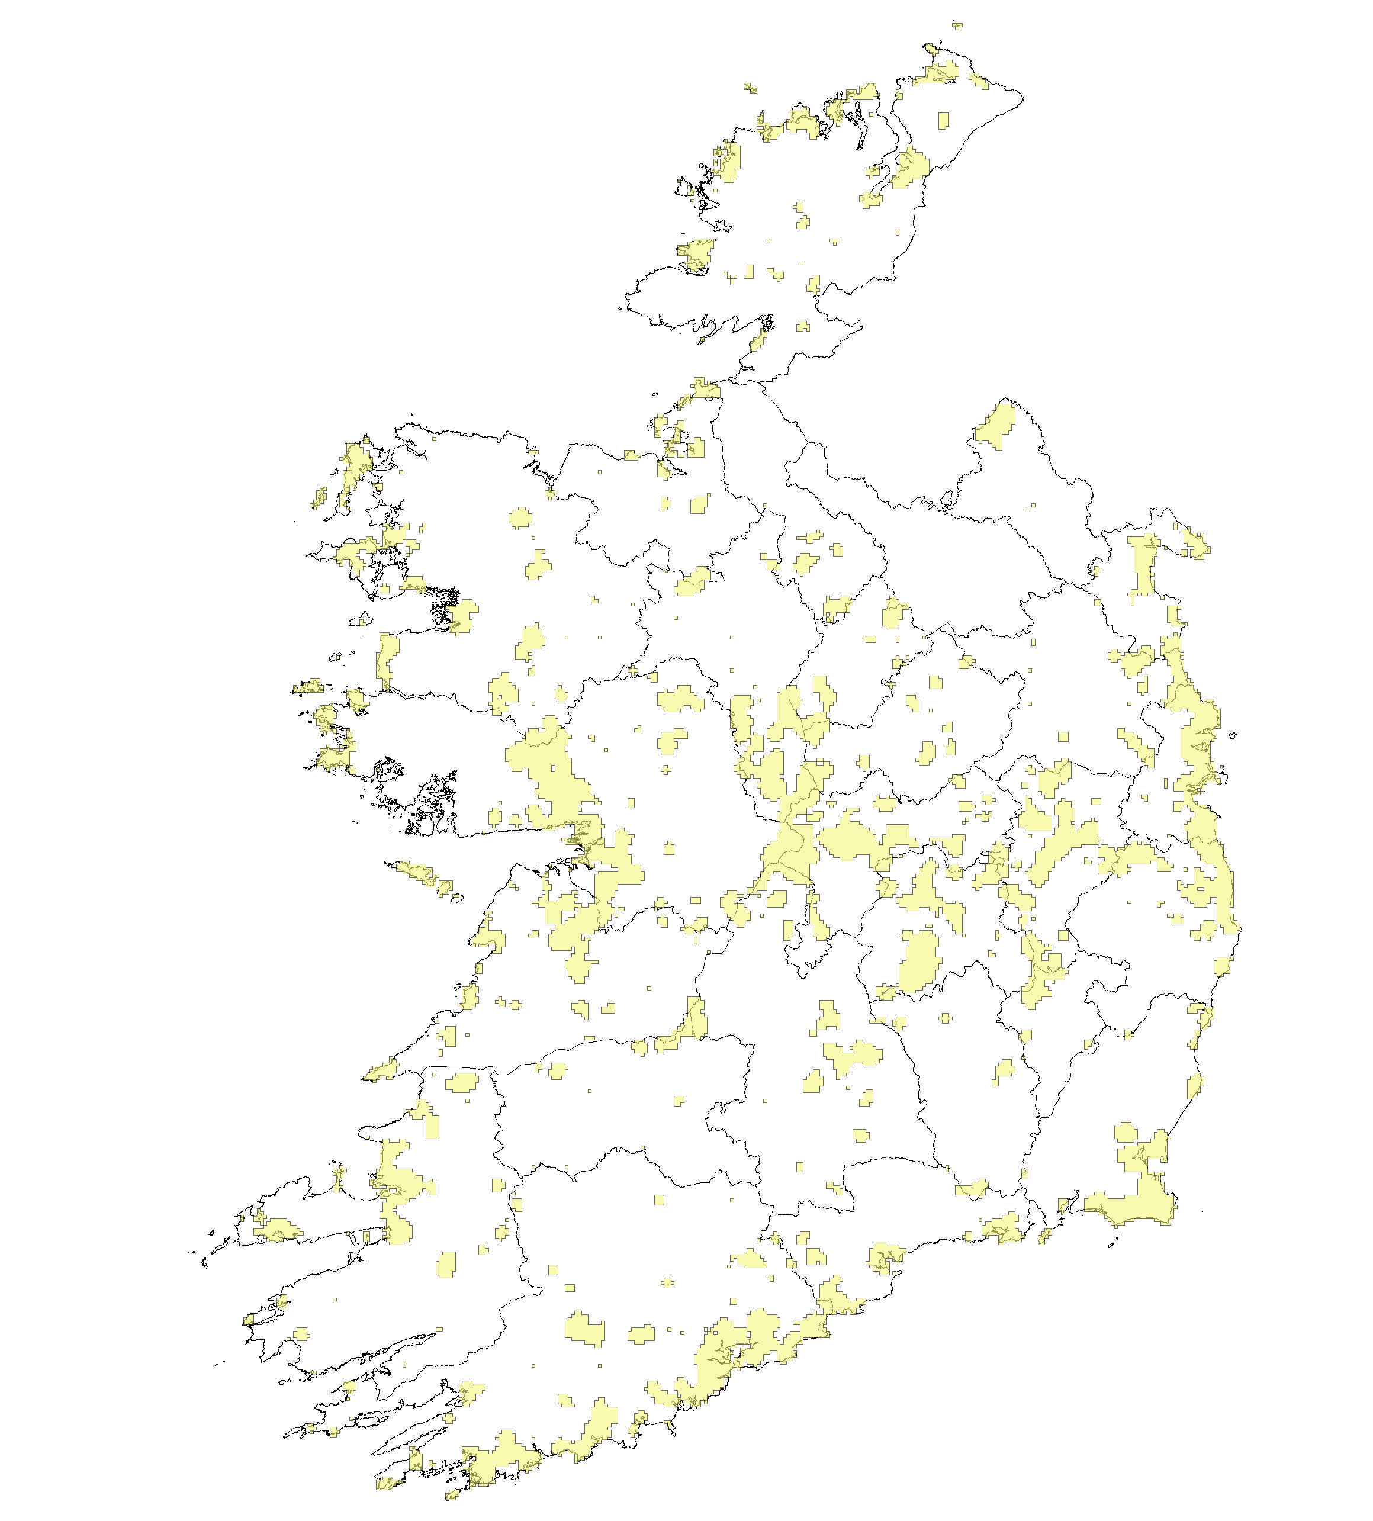
BWI Farmland Bird Hotspots

Slide 7
Cohort of Files
Cohort 1 - already licensed but not planted, opt-in for financial approval – assessment by DAFM
Cohort 2 – in the system, opt-in required, assessment by DAFM
Cohort 3 – files yet to be submitted, assessment by applicant
Ecology – Cohort 1 and 2

Slide 8
Assessment of HNVf
Intensive managed farmlands
report justifying
Cohort 3 – not referred to Ecology
Field procedure
Habitat survey
Species survey as per R+N
Field season considerations
HNVf recording sheet (draft – in trial)
Assessment of thresholds
Work ongoing
All FTs eligible or only native woodland FTs or refusal

Slide 9
Assigned Work
Field inspect HNVf only
Not required to do peat depth survey
Take soil depth in each releve
Not making a decision in relation to whether or not it is HNVf
Capturing data only
Saved in folder in G Drive (link to be circulated).

Slide 10
Prior to site survey
Using the aerial view maps, based on the varieties of colours of the fields, determine the approximate likely number of plantable habitats present on the site and count the number of fields present.
Print one HNVf field survey sheets for each habitat type (Bring spares).
Print out the habitat mapping map from Franks folder for mapping to Fossitt in the field.
Plan your relevé spots (approximate)
An Roinn Talmhaíochta, Bia agus Mara │ Department of Agriculture, Food and the Marine

Slide 11
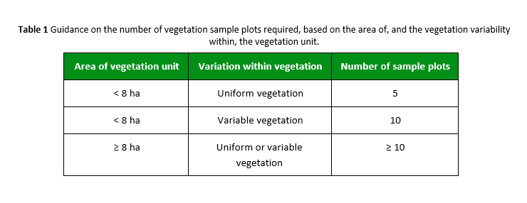
Relevés
Use professional judgement
An Roinn Talmhaíochta, Bia agus Mara │ Department of Agriculture, Food and the Marine

Slide 12
Field sheet background
Adapted from Acres
Designed to determine baseline conditions to inform management and not identify HNVF
But
Uses some of the same key indicators for assessment as is used to identify HNVf
An Roinn Talmhaíochta, Bia agus Mara │ Department of Agriculture, Food and the Marine

Slide 13
Bring
As well as your normal field survey equipment/books/clipboard/notebook/camera etc ensure you bring:
A printed map for habitat mapping and annotation in the field
The required number of HNVf field survey sheet.
An Roinn Talmhaíochta, Bia agus Mara │ Department of Agriculture, Food and the Marine

Slide 14
Field procedure summary
Relevés in a representative location
Map to Fossitt
Observe and record on field sheet
Take overview and detailed pics of relevance
An Roinn Talmhaíochta, Bia agus Mara │ Department of Agriculture, Food and the Marine

Slide 15
Relevés
Vegetation sampling plots or relevés measuring 2m x 2m
Take photos
Record % cover of species
Record the relevé location
Avoid any unrepresentative features such as drains and boundary edges.
An Roinn Talmhaíochta, Bia agus Mara │ Department of Agriculture, Food and the Marine

Slide 16
Before moving on from relevé
Define the habitat type to Fossitt (2000)
Map the habitat on your map and any others you can see
Begin the field sheet survey at the relevé assessing species richness and vegetation structure
If the habitat is potentially Annex I then conduct assessment for Annex I habitat as per relevant methodology
Move onto next relevé
An Roinn Talmhaíochta, Bia agus Mara │ Department of Agriculture, Food and the Marine

Slide 17
As you move between relevés across the site
Continue mapping habitats to Fossitt
Continue filling in the field sheet including habitat quality, field boundary details etc
If you are encountering substantially different habitats you may need separate field sheets
If the habitat is the same or similar the relevé should not take long
An Roinn Talmhaíochta, Bia agus Mara │ Department of Agriculture, Food and the Marine

Slide 18
As you move between relevés across the site
If a habitat within a field boundary, unplantable area, or area of ABE is not representative of the site, do not complete a relevé in it but do take notes on the habitat.
Take note of any important/rare/protected habitats or species within or directly adjacent as per normal field survey
Ensure your notes are legible and clear.
An Roinn Talmhaíochta, Bia agus Mara │ Department of Agriculture, Food and the Marine

Slide 19
Before you finish up
Ensure that your habitat map is complete
Ensure that you have completed a relevé in all plantable areas
Review your notes to check for any missing details on
Habitat map
Field sheet
Relevé sheet/s
An Roinn Talmhaíochta, Bia agus Mara │ Department of Agriculture, Food and the Marine

Slide 20
Upon return to the office
Upload your annotated Fossitt map to file (G drive/eDocs central location – details to follow).
Ensure that all details are legible and if necessary redraw or digitise if not.
Scan and upload your field survey sheets. As above re-do if illegible.
Upload the relevant photos and save in a pdf document numbered to correspond with the habitats/field notes/plots/
An Roinn Talmhaíochta, Bia agus Mara │ Department of Agriculture, Food and the Marine

Slide 21
HNVF Interim survey procedure finalisation for now
Save all of the data to the relevant file folder on the shared drive.
You, or another staff member will use this later to conduct the assessment when the thresholds have been set and scoring system defined
An Roinn Talmhaíochta, Bia agus Mara │ Department of Agriculture, Food and the Marine

Slide 22
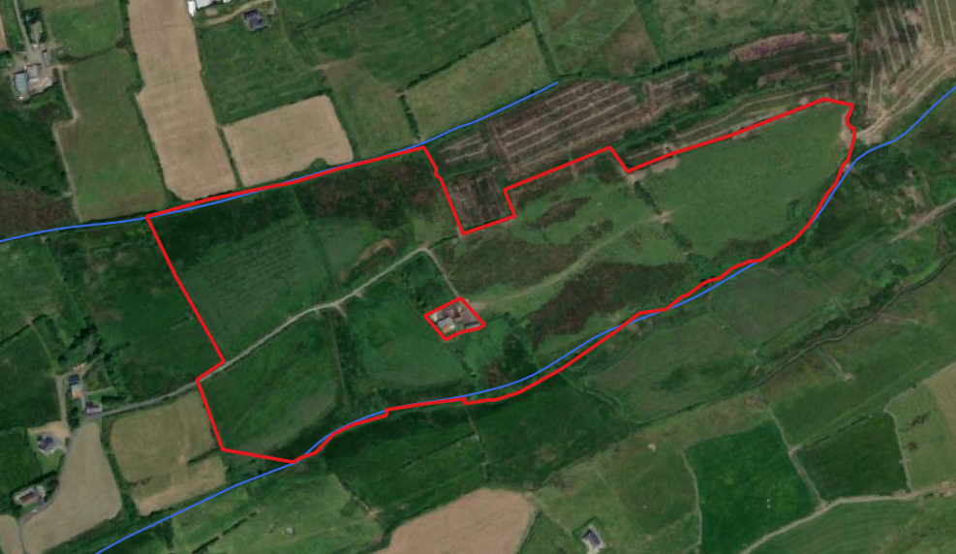
CN91523
Within the HNVf high likelihood layer
An Roinn Talmhaíochta, Bia agus Mara │ Department of Agriculture, Food and the Marine

Slide 23
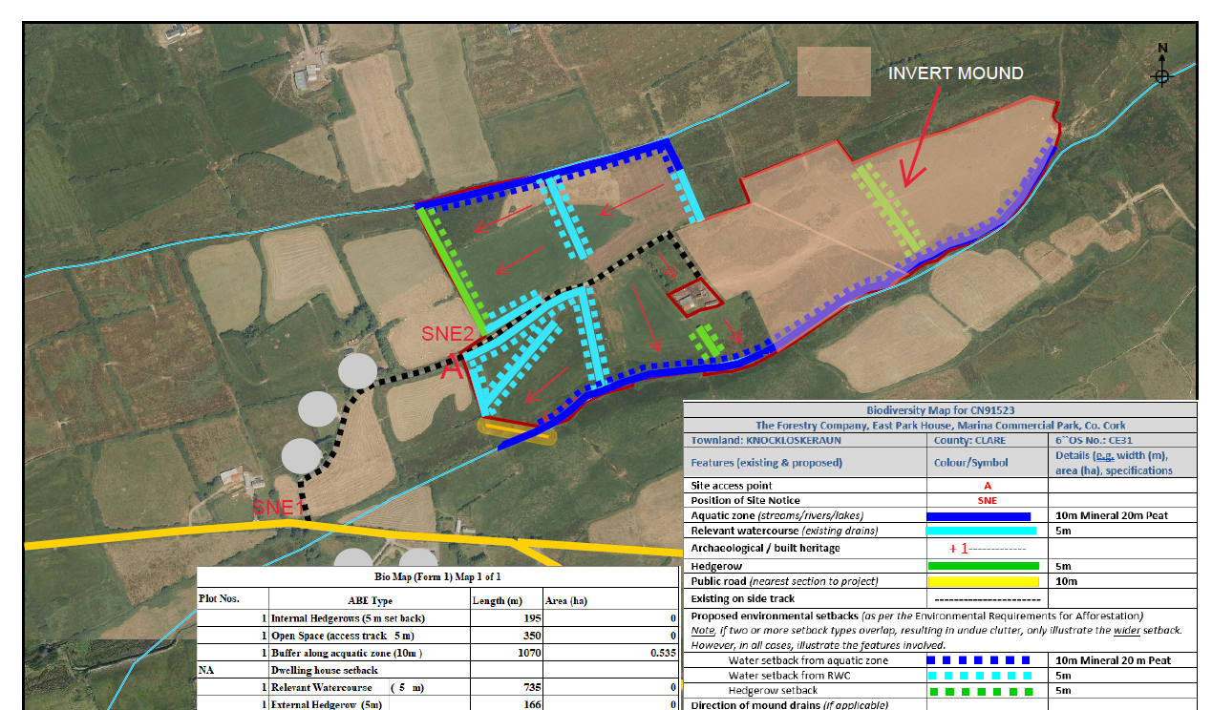
Example relevés
An Roinn Talmhaíochta, Bia agus Mara │ Department of Agriculture, Food and the Marine

Slide 24
An Roinn Talmhaíochta, Bia agus Mara │ Department of Agriculture, Food and the Marine

Slide 25
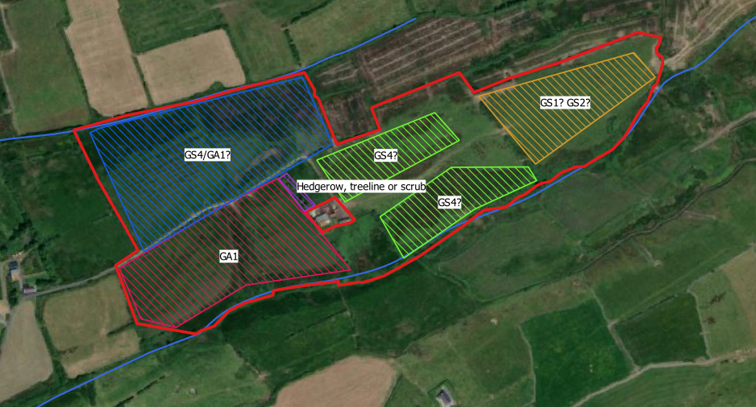
An Roinn Talmhaíochta, Bia agus Mara │ Department of Agriculture, Food and the Marine

Slide 26
A
An Roinn Talmhaíochta, Bia agus Mara │ Department of Agriculture, Food and the Marine

Slide 27
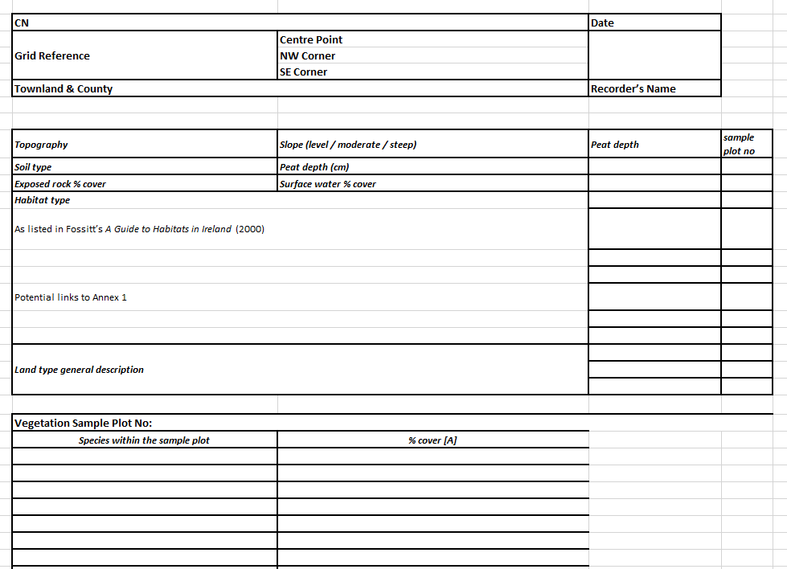
Example relevés
An Roinn Talmhaíochta, Bia agus Mara │ Department of Agriculture, Food and the Marine

Slide 28
Example field sheet
An Roinn Talmhaíochta, Bia agus Mara │ Department of Agriculture, Food and the Marine

