Slide 1
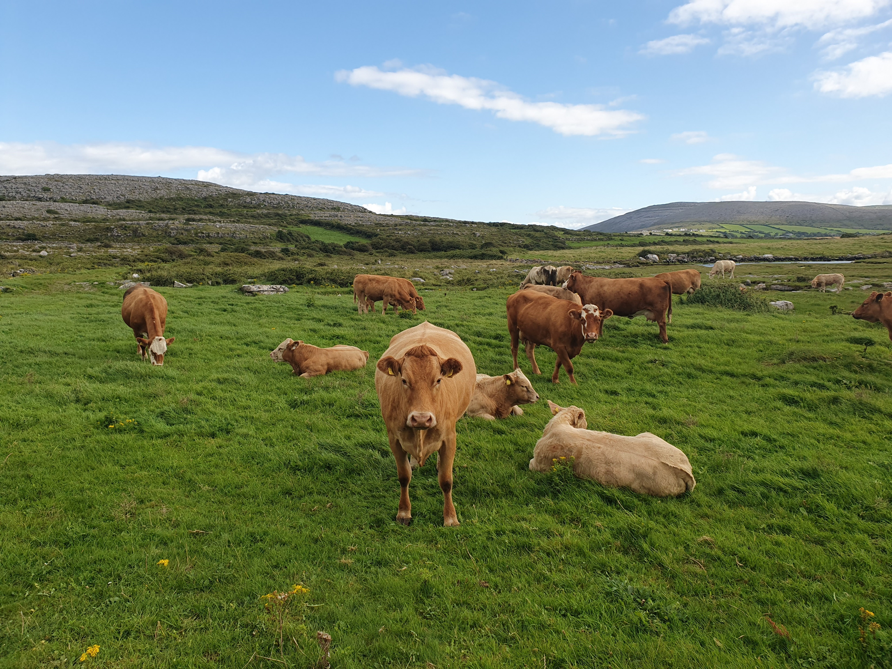
Environment and agriculture
J Deakin, AM Ryan, D Styles, B Hyde
With thanks to reviewers from Teagasc, DAFM, NPWS, ATU, EPA

Slide 2
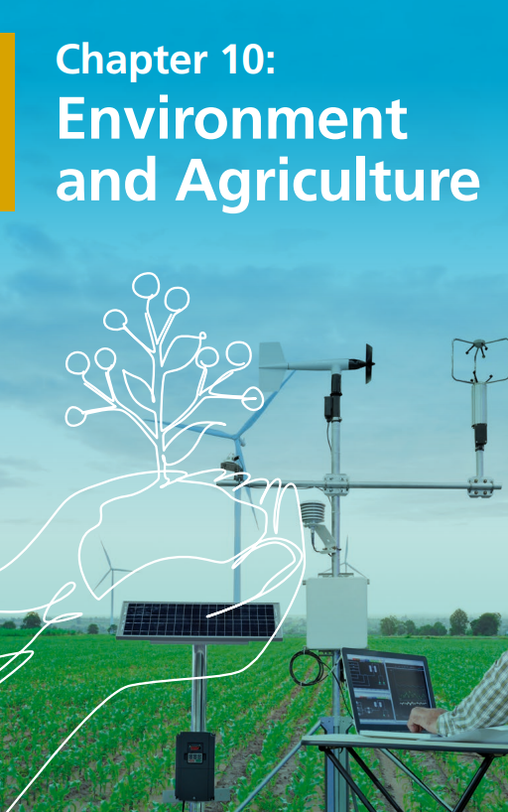
Outline of the chapter
Overview of the agricultural sector
Challenges with the Food System
Environmental challenges
Plans and programmes in place
Will they deliver?
Key messages

Slide 3
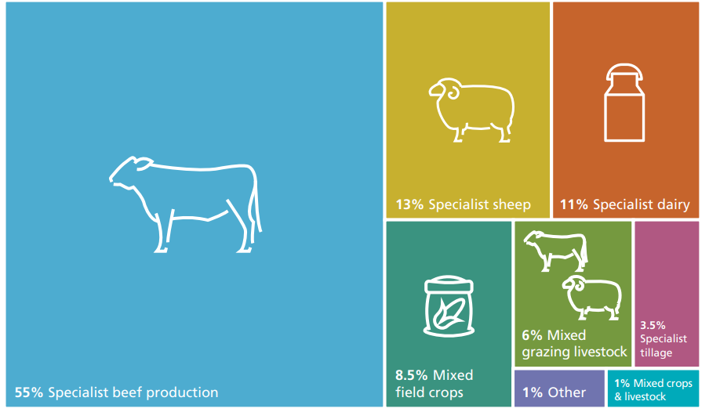
Farming in Ireland
135,000 farms, average size 33ha
4.5M ha total, 4.1M ha grassland
An integral part of Ireland’s society and economy
€18.8 Billion in exports to 180 countries (2022)
Food and drink exports = 38% all exports (2020)
170,400 jobs = 7% all employment

Slide 4
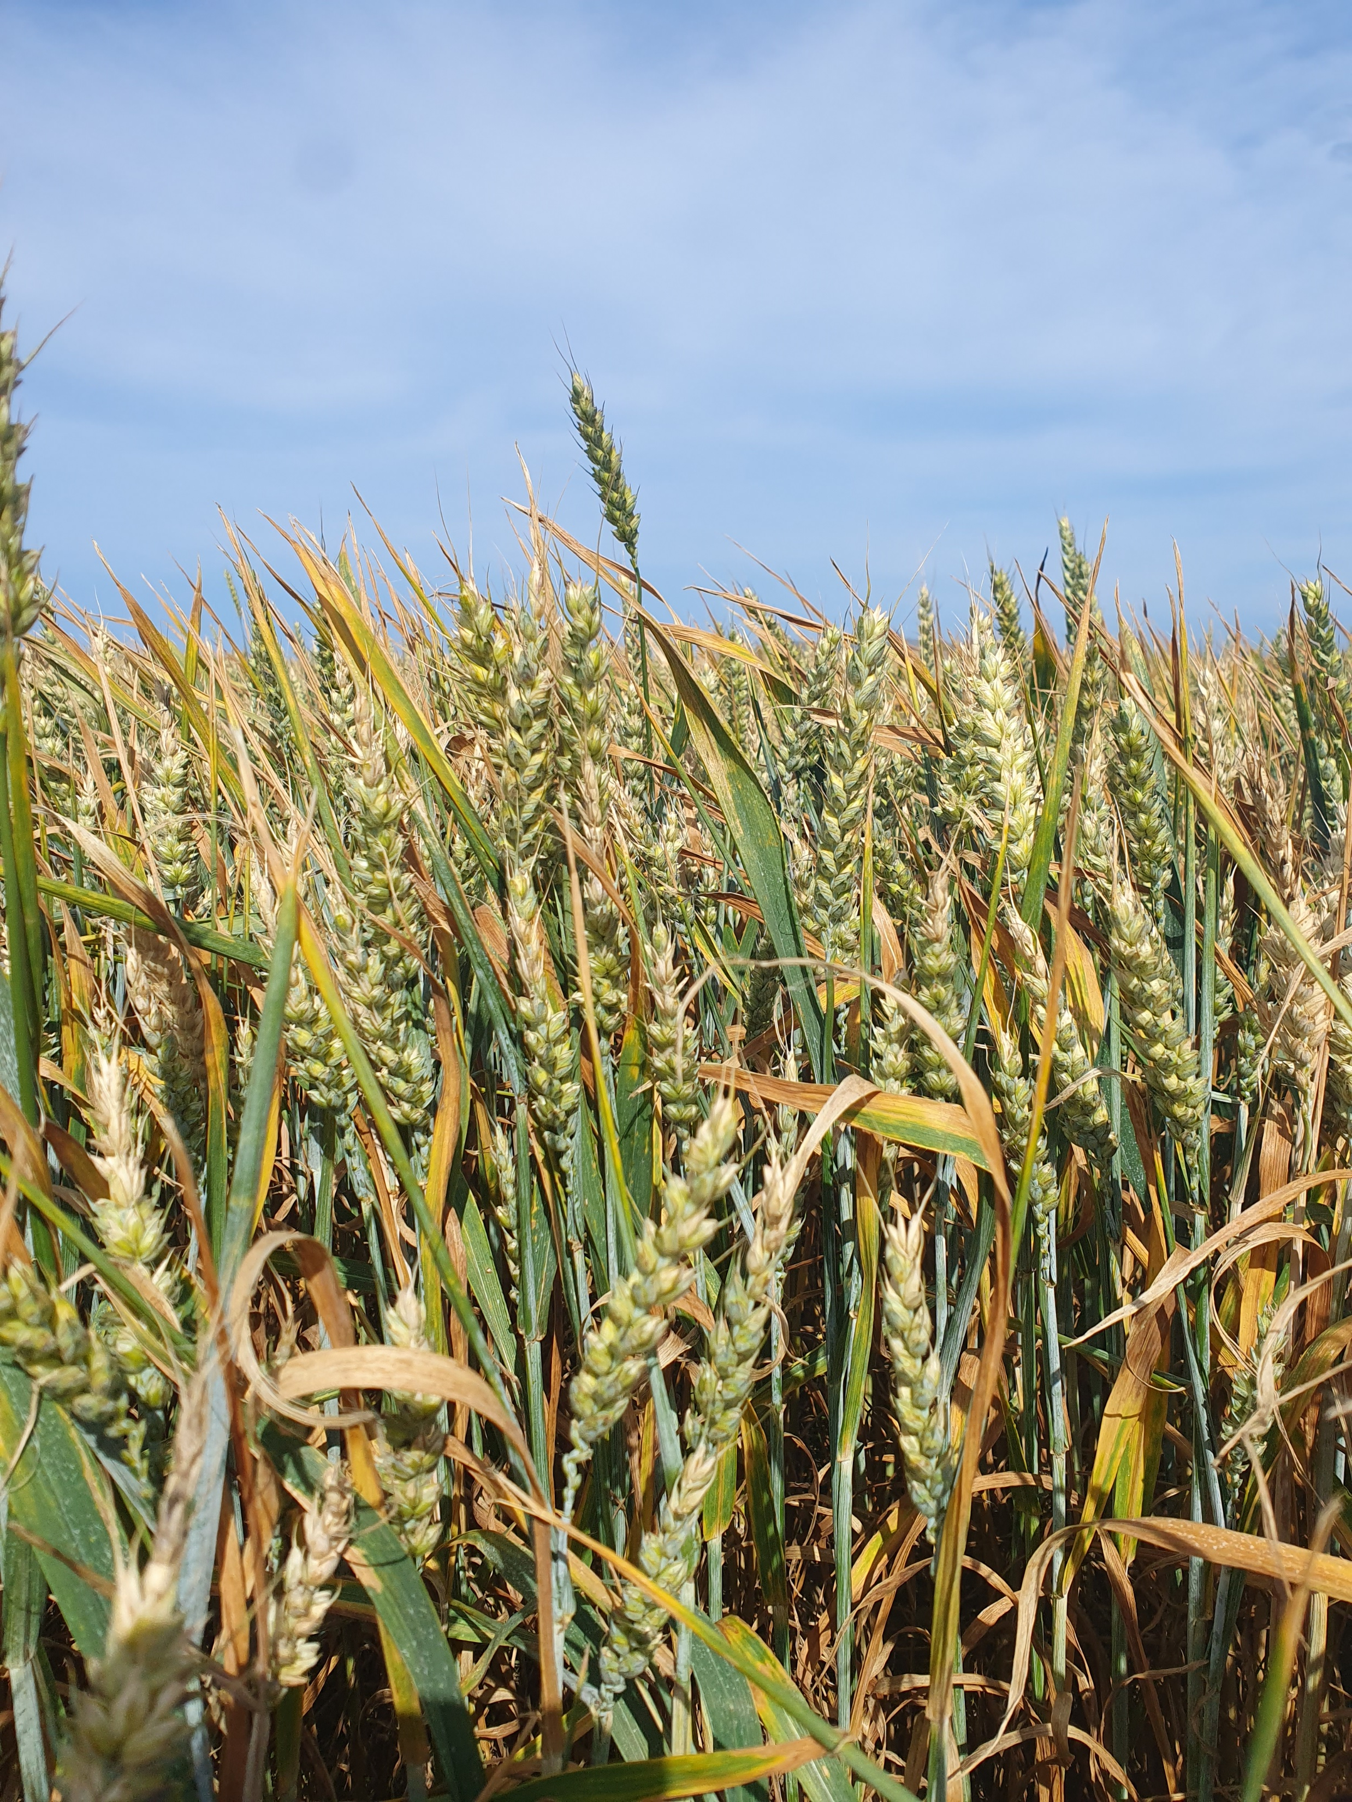
Challenges with the Food System
Environmental impacts
(air, water, climate, biodiversity)
Climate change adaptation
Farm viability (economics, succession)
Technology and innovation
Food waste
Competing demands for land, challenges with scale
3 successive food policies haven’t yet delivered

Slide 5
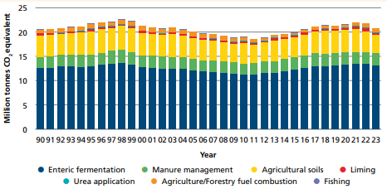
Environmental impacts: Climate
38% of GHGs from agriculture (CO₂, nitrous oxide and methane)
Key drivers: cattle numbers and nitrogen fertilisers
Significant reductions in chemical N use have been achieved
Target is 25% reduction in emissions by 2030.
Projections are up to 18% reduction depending on measures implemented. Additional policy levers required.
Not on track

Slide 6
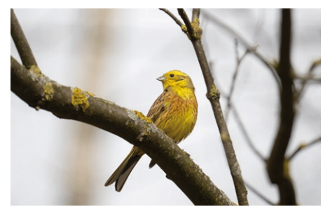
Environmental impacts: Biodiversity
85% protected habitats and 43% species at unfavourable condition. 63% of bird species declining, esp farmland birds, breeding waders
Issues: loss of habitat eg wetlands, species rich grasslands. Pollution and drainage
Biodiversity provides many ecosystem services
Court ruling that Irl has failed to meet obligations
Prioritised Action framework published. Measures expected to cost €1.14B (2021-2027)
Not on track
Notes:
Biodiversity in the food system provides critical ecosystem services such as creating and maintaining healthy soils, pollinating plants, controlling pests and providing habitat for wildlife, plants, fish and domesticated species that are vital to food production and sustaining agricultural livelihoods. Biodiversity makes food production systems more resilient to external shocks and stresses, such as droughts, flooding and temperature extremes, which will all become more frequent with climate change. Diverse production systems, for example using multispecies swards and different crop and animal species and breeds, and integrating the use of crop, livestock, forestry and aquatic biodiversity in landscape systems, help to promote resilience, improve livelihoods and support nutritious, secure food production

Slide 7
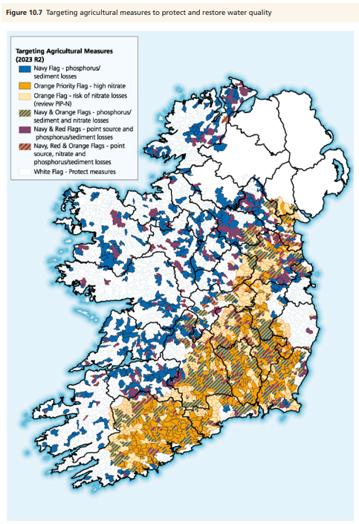
Environmental impacts: Water
46% of waterbodies not meeting water quality objectives
Agriculture the biggest impact, >1000 waterbodies
Key issue: Loss excess nutrients from organic and chemical fertilisers
Improvements offset by declines. Actions need to be targeted. 5 Nitrates Action Programmes haven’t yet delivered
Issues also with loss of habitat condition and chemicals
Not on track

Slide 8
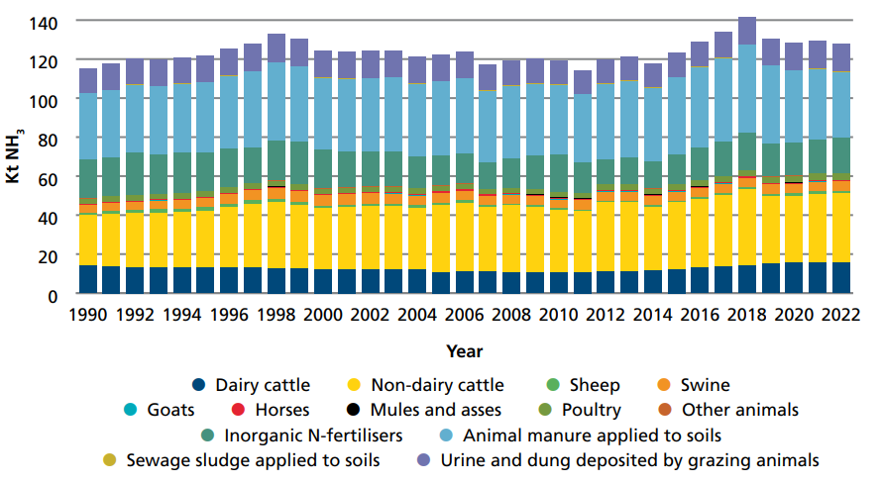
Environmental impacts: Air
99% of total national ammonia emissions is from agriculture
Sources: cattle, organic and non-organic N fertilisers
International reduction
commitments not currently met
Infringement case commenced
2030 targets could be met but would need additional policy levers
Actions: reduction in chemical N, protected urea, LESS
Not on track

Slide 9
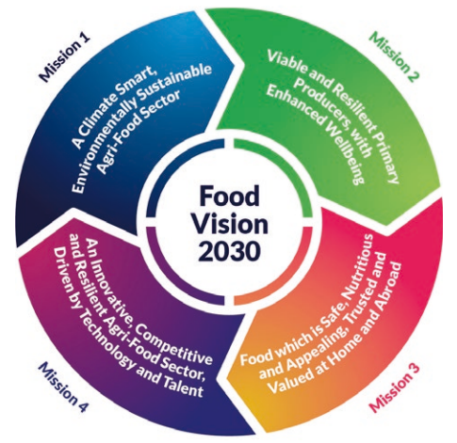
Plans and programmes in place
Lots! Many driven by the European Green Deal
Common themes:
  Reduction of chemical and nutrient pollution
  Challenging to implement, sector concerns
  Farmers must be supported
Common Agricultural Policy budget €9.8B/5 years (incl €2.3B for rural development/agri-environment schemes
Ireland is a leader in results-based payments approaches

Slide 10
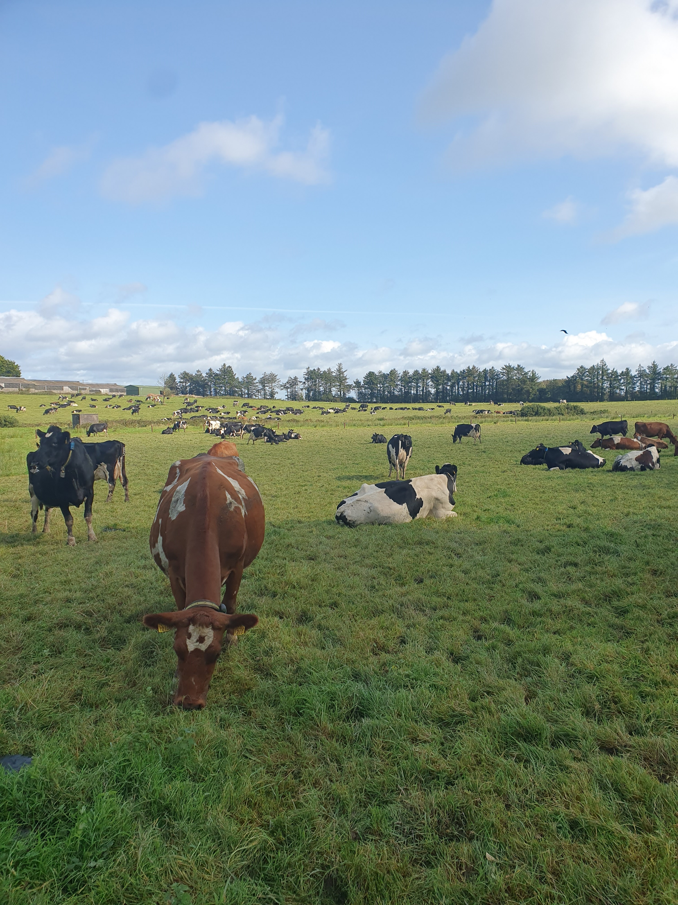
Will they deliver?
Significant progress is being made
Currently not on track. No evidence that the current measures are enough. Focus on efficiency.
We know broadly what has to be done for short term targets. Needs a step up in implementation
Actions need to be quantifiable, recorded, tracked and evaluated to determine effectiveness – looking backwards and forwards
Needs a collaborative, integrated, accountable, whole of sector approach. Policy integration and coherence is a challenge

Slide 11
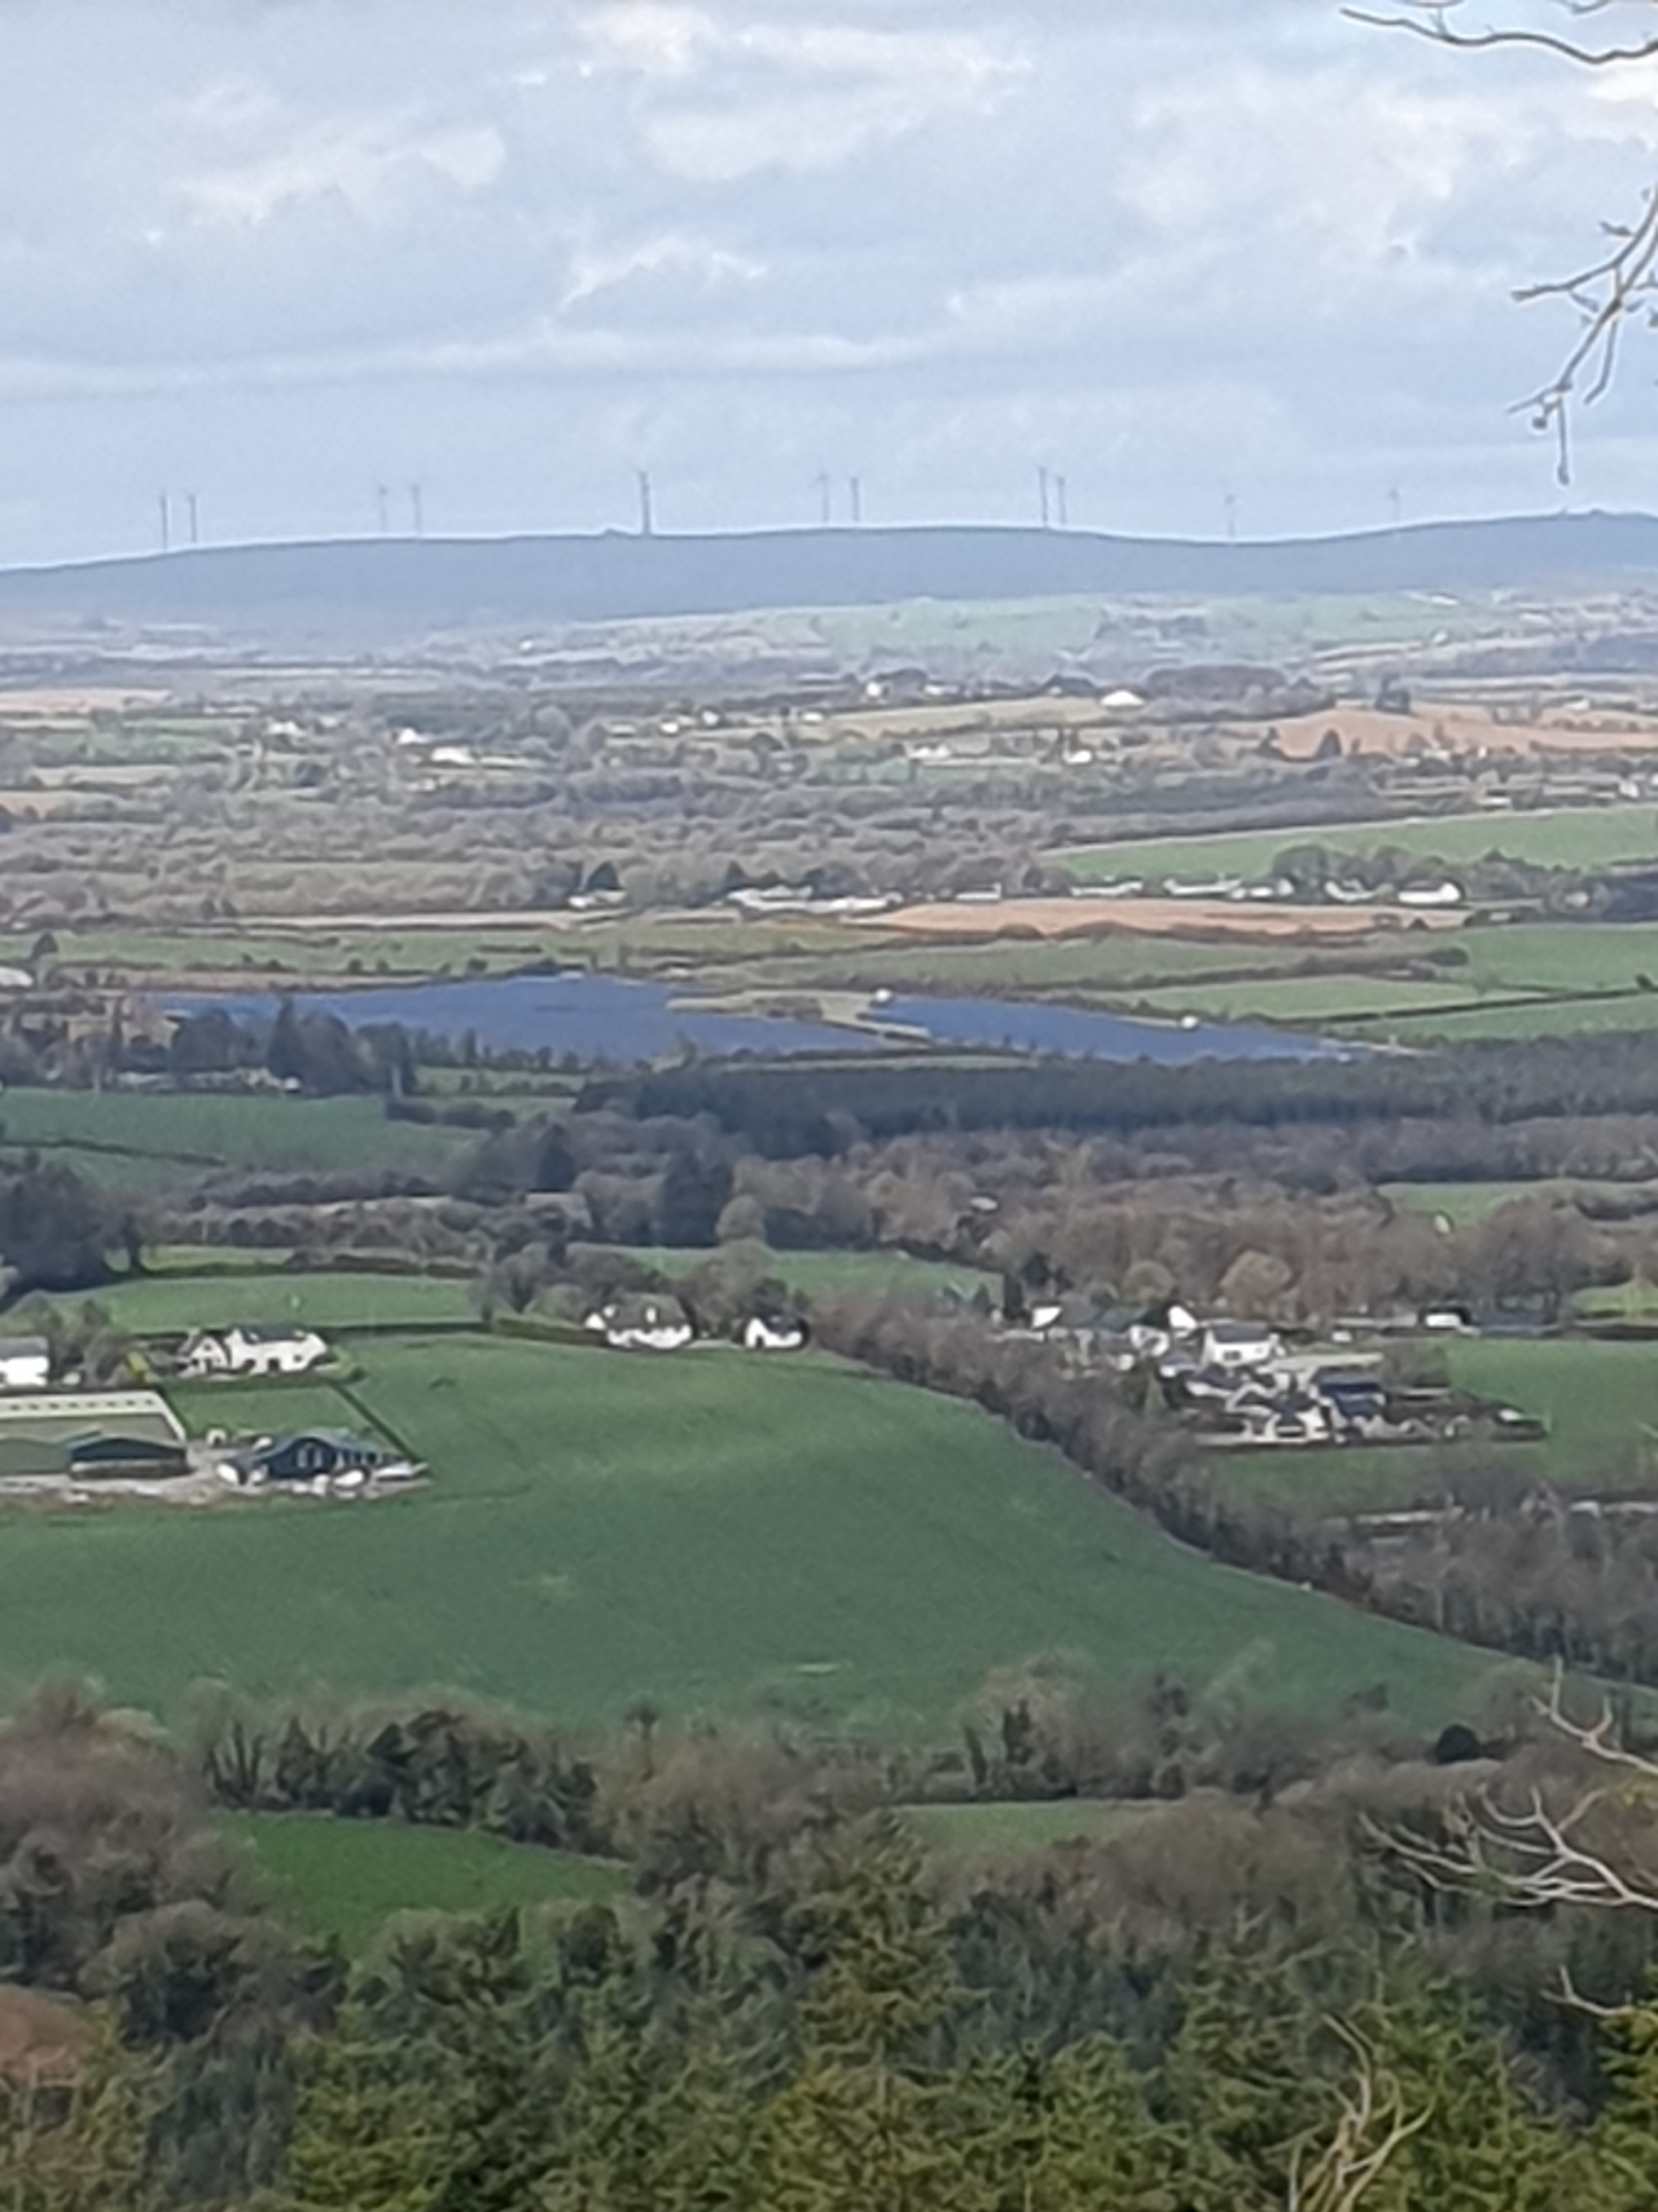
Farming for the future?
A shared long-term vision for landscape and food system, to deliver all ecosystem services is needed
Set clear trajectories reflecting the scale and pace needed – transformational change. Track progress and evaluate
Farm in harmony with nature and safe limits of healthy functioning ecosystems. Build resilience to adapt to climate change impacts.
Capitalise on the circular bioeconomy opportunities. Reduce food waste
Support landholders to make necessary changes. Fair returns for farmers. Just transition

Slide 12
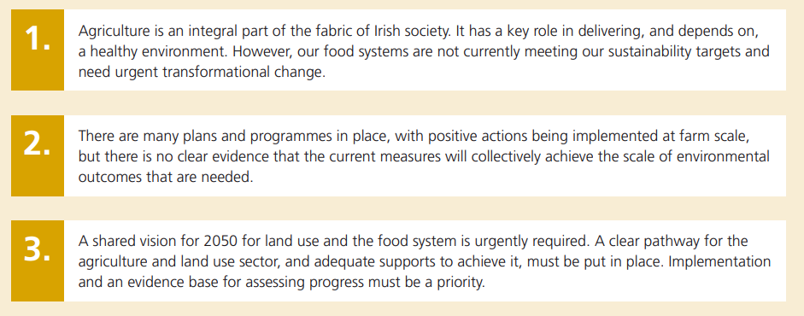
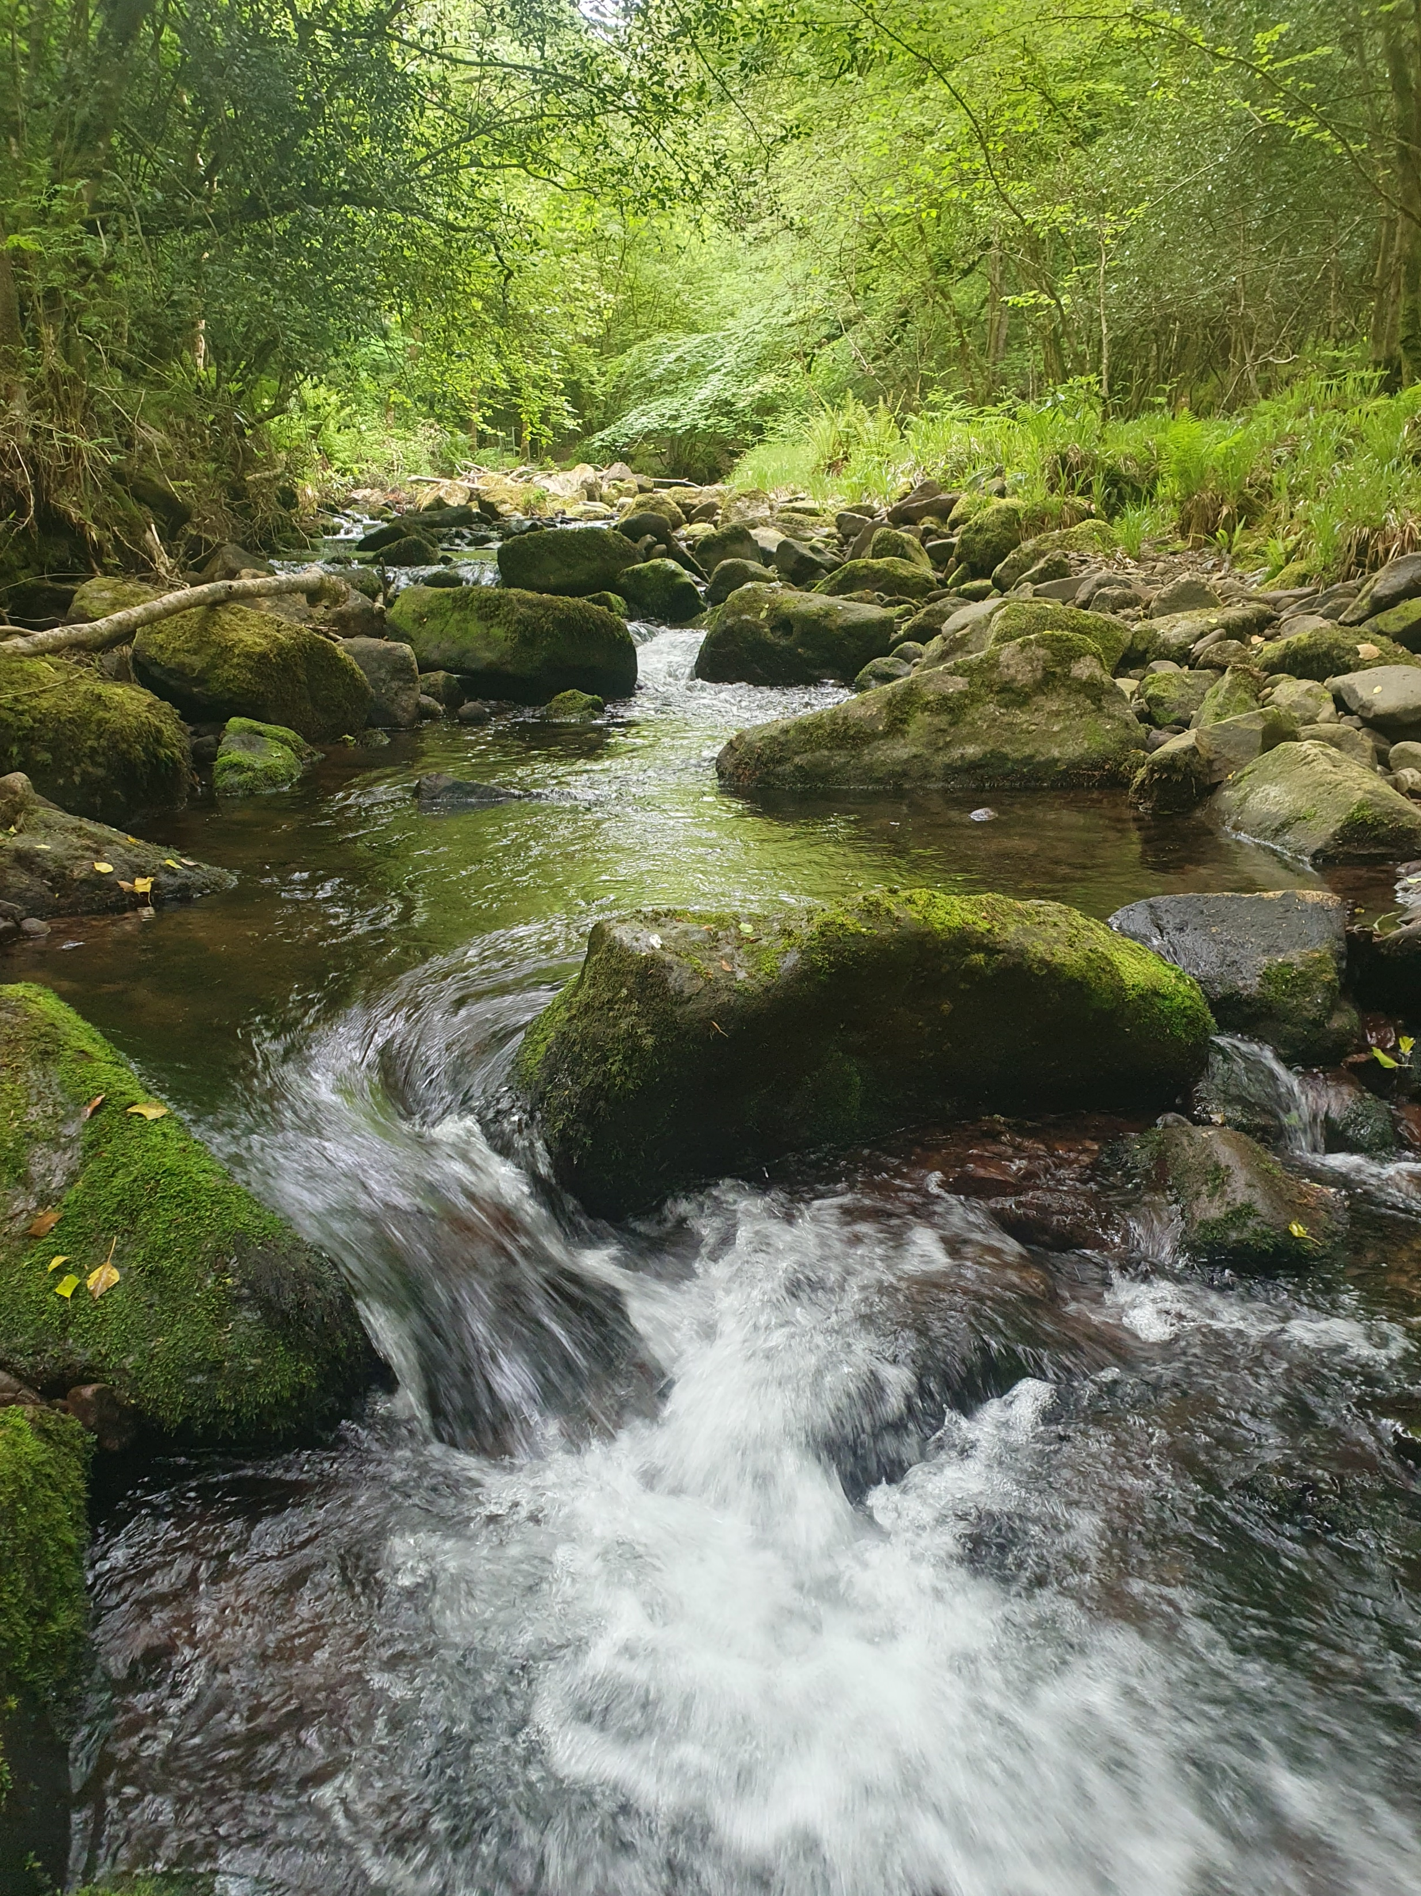
Key messages

