Slide 1
Met Éireann NFFWS Update February 2023
Notes:
To change the image on this slide, select the picture and delete it. Then click the Pictures icon in the placeholder to insert your own image.

Slide 2
3.1.1 Progress on FFC staffing
Prepare job specifications and co-ordinate recruitment of MÉ FFC Staff
1 Chief Hydrometeorologist (PO Equivalent)
9 Hydrometeorologist (AP Equivalent)
1 Principal Meteorological Officer (AP Equivalent)
Organise and provide MÉ FFC Staff with accommodation in Met Éireann
All FFC staff have been working in Glasnevin since COVID-19 restrictions were lifted earlier in 2022
Met Éireann FFC Staff training
FFC staff have undertaken training in a number of areas:
FEWS – use and development of the system
HYPE – additional training on the fluvial model
TSSF – training on the integration of the TSSF model at ECMWF HPC, as well as working in the HPC environment
Scientific programming languages – python, R and Linux
Notes:
Today
River levels are set to ELEVATED in the north west
This is for smaller quick responding rivers.
Tomorrow this extends to many parts
On Saturday many places remain ELEVATED due to the high rainfall totals expected

Slide 3
3.1.1 Progress on FFC staffing
Task 1c: Set-up
Establish a 24-hour capability at the FFC
A 24-hour capability at the FFC has been in place for a number of years
Important to note that this is a limited service
The on-call roster which is in effect continues to be an efficient means of providing hydro-meteorological support to the Forecast Division in Met Éireann as well as to NECG meetings
This support proved useful during Storms Dudley, Eunice and Franklin in February 2022
Notes:
Today
River levels are set to ELEVATED in the north west
This is for smaller quick responding rivers.
Tomorrow this extends to many parts
On Saturday many places remain ELEVATED due to the high rainfall totals expected

Slide 4
3.2 development & Trial of Flood Forecasting models
Fluvial model build
MÉ staff have completed development of the HYPE model for the remaining 24 Hydrometric Areas not included in the original IMDC projects. 36 Hydrometric Areas fluvial forecast models have been built.
This means that for the first time there in a National fluvial forecast model in place for Ireland
It is important to note that some catchments could not be calibrated to an adequate level due to the lack of high quality real time river flow observations
All of the 36-catchment fluvial models have been integrated into the National FEWS System.
Both deterministic Harmonie and ECMWF runs are produced as well as the probabilistic IREPS and ECMWF EPS.
Notes:
Today
River levels are set to ELEVATED in the north west
This is for smaller quick responding rivers.
Tomorrow this extends to many parts
On Saturday many places remain ELEVATED due to the high rainfall totals expected

Slide 5
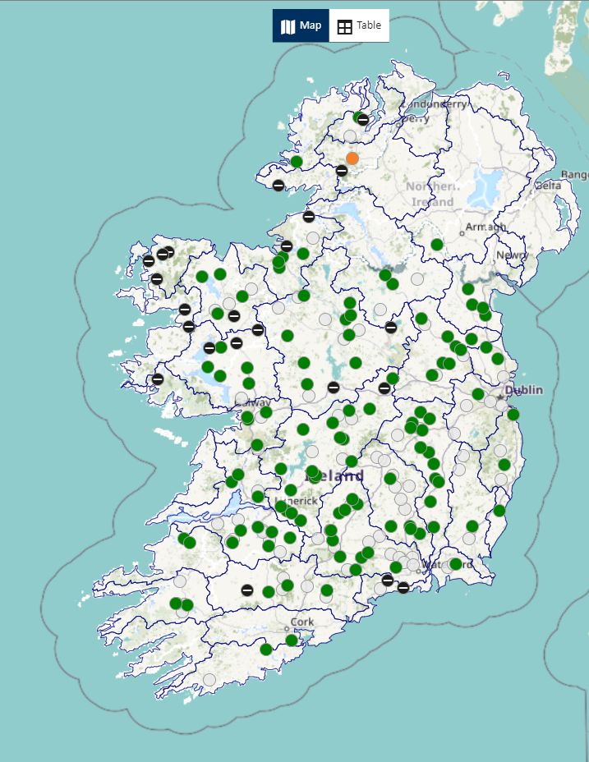
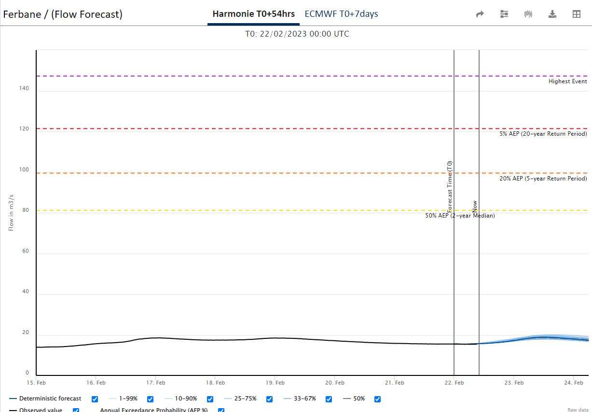

Slide 6
3.2 development & Trial of Flood Forecasting models
FEWS System – Data Flow
NWP data – both Harmonie deterministic and probabilistic forecast data is being sent to the FEWS system
ECWMF – deterministic and probabilistic forecasts are also sent to FEWS.
OPW water level data is being sent to the FEWS system
Radar and weather observation data is being sent to the system
FEWS System – Forecasts
The Hydrological model used is HYPE from SMHI.
The 36 Catchment Models run 6 times a day, and these runs correspond to
the 4 Harmonie NWP forecasts at 6 hourly intervals - 54 hours
and 2 ECMWF NWP forecasts at 12 hourly intervals - 7 days
Notes:
Today
River levels are set to ELEVATED in the north west
This is for smaller quick responding rivers.
Tomorrow this extends to many parts
On Saturday many places remain ELEVATED due to the high rainfall totals expected

Slide 7
3.2 development & Trial of Flood Forecasting models
FEWS System – Cloud Hosting
Rather than an on premises server approach, FEWS is cloud based, in line with the Government approach of Cloud first solutions
Cloud based systems allow for greater geo- resilience, ease of access, additional cloud-based security and ease of expanding the system
Ireland is one of the first national flood forecast services to adopt a Cloud Based FEWS
FEWS System – Project Management
The FEWS system handover completed in 2022 and the cloud hosting, support and maintenance period started.
The Hosting, Support and Maintenance Contract is for a period of 3 years with the option to extend the contract up to 7 years.
Delft FEWS is modular and this will allow the System to be improved and developed throughout the contract period.
Notes:
Today
River levels are set to ELEVATED in the north west
This is for smaller quick responding rivers.
Tomorrow this extends to many parts
On Saturday many places remain ELEVATED due to the high rainfall totals expected

Slide 8
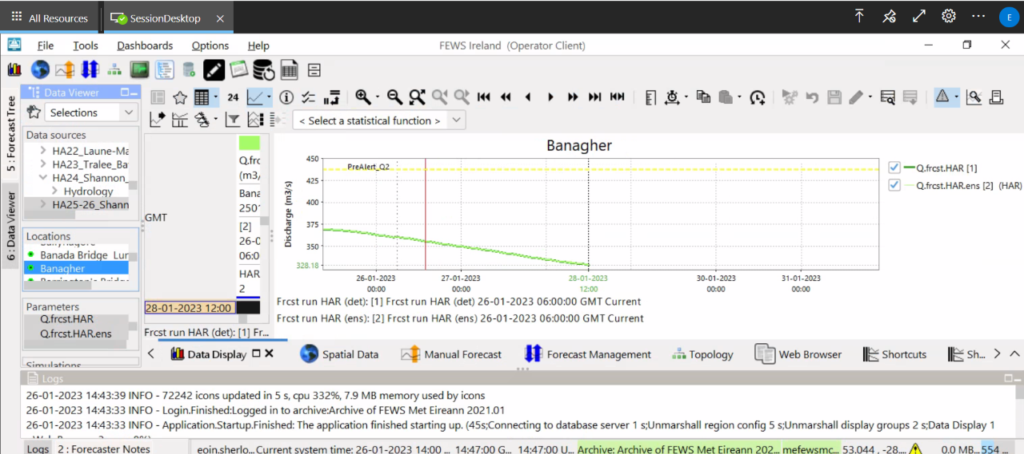

Slide 9
3.3 non-operational trial
FFC non-operational trial
In Q4 2021 the non-operational trial commenced
The purpose of this non-operational trial was to test the processes and systems that were developed throughout Stage 1
This included the dissemination of the trial Daily Flood Guidance Statement product to key stakeholders
The FEWS system which schedules the HYPE fluvial models also formed part of the trial. The performance of this system was monitored
The TSSF model initially being run via the OPW’s Contractors then the TSSF model which was transferred to the ECMWF HPC will also be reviewed
FFC staff maintained a log of all incidents with the various systems and models, flooding events etc.
Notes:
Today
River levels are set to ELEVATED in the north west
This is for smaller quick responding rivers.
Tomorrow this extends to many parts
On Saturday many places remain ELEVATED due to the high rainfall totals expected

Slide 10
3 tssf model
TSSF Model – Technical trial
Met Éireann developed the TSSF model so that it could be included as a time critical system at the ECMWF HPC.
In July 2022 Met Éireann applied to the ECMWF to include the TSSF model as a time critical suite on their HPC infrastructure
In October 2022, ECMWF approved the work that Met Éireann had completed to ensure that the TSSF model was up to the standards required for the TSSF model to become an operational system on the HPC
This significant amount of work involved a number of trials, the development of bespoke scripts with the model developers DHI as well as the creation of a scheduling system to run the TSSF model on the old and new HPCs (Reading and Bologna).
Notes:
Today
River levels are set to ELEVATED in the north west
This is for smaller quick responding rivers.
Tomorrow this extends to many parts
On Saturday many places remain ELEVATED due to the high rainfall totals expected

Slide 11
3 tssf model
TSSF Model – Technical trial
TSSF model has been running on the ATOS machine in Bologna since October 2022.
The aim is to run the TSSF to monitor its performance and to produce a report on its performance during any periods of heightened coastal flood risk as part of the non-operational trial
Additional work has already been required to increase the resilience of the TSSF model at ECMWF
Met Éireann have procured the services of a Contractor to maintain the current TSSF model and website until later this year
TSSF Service Formal Transfer from OPW to Met Éireann
A formal transfer plan must be developed in order to ensure the smooth transfer of the TSSF Service from the OPW to Met Éireann
Initial discussions have taken place between both parties with the objective to develop this plan with a set schedule
Notes:
Today
River levels are set to ELEVATED in the north west
This is for smaller quick responding rivers.
Tomorrow this extends to many parts
On Saturday many places remain ELEVATED due to the high rainfall totals expected

Slide 12
3 tssf model
TSSF Model – Technical tasks
TSSF model will continue to run on the HPC machine in Bologna to to capture any additional coastal events.
Met Éireann will continue to harden and increase the resilience of the environment that the TSSF model runs in
Determine what will happen to the TSSF model forecast archive from when the OPW ran the model and from the time that Met Éireann ran the model
Documentation on how to run the TSSF model for Met Éireann and for ECWMF staff.
Complete training in python, ECFLOW, Linux for Met Éireann staff so that they can troubleshoot issues with the TSSF model when on-call
Notes:
Today
River levels are set to ELEVATED in the north west
This is for smaller quick responding rivers.
Tomorrow this extends to many parts
On Saturday many places remain ELEVATED due to the high rainfall totals expected

Slide 13
3 tssf model
TSSF Model and IFICS
TSSF model forecasts will need to be transferred from the HPC to the IFICS system
Training for end users on how to use the IFICS system to visualize and interpret the TSSF model forecasts
Development of User Manuals will complete the training
Coastal Thresholds – Third party commissioned to produce these for the TSSF model – Met Éireann have requested the OPW to assist in the provision of the final thresholds – they have contacted the Limerick FRS steering group to approve the levels – these will be integrated into the IFICS system to provide coastal thresholds for the various TSSF model forecast output locations
A product will be developed in IFICS to allow a HTA product or similar to be disseminated to stakeholders
The OPW to provide the definitive dissemination list
Notes:
Today
River levels are set to ELEVATED in the north west
This is for smaller quick responding rivers.
Tomorrow this extends to many parts
On Saturday many places remain ELEVATED due to the high rainfall totals expected

Slide 14
3 tssf model
TSSF Model and Communications
OPW to communicate to the various stakeholders that the TSSF Service will formally transfer to Met Éireann
Met Éireann will engage with the NDFEM to determine if the MEM Framework documents require modifications
Met Éireann to use the SWFLM network to engage with Local Authorities to ensure they are briefed on the transfer and they are prepared to access the new system.
Existing TSSF Service
Agreement on the appropriate means to formally transfer the TSSF service from the OPW to Met Éireann
Agreement on formal handover date
Notes:
Today
River levels are set to ELEVATED in the north west
This is for smaller quick responding rivers.
Tomorrow this extends to many parts
On Saturday many places remain ELEVATED due to the high rainfall totals expected

Slide 15
5 governance
Financial Arrangements
Agreed OPW Funding: €871,000.00
Balance: €41,361.28
Notes:
Today
River levels are set to ELEVATED in the north west
This is for smaller quick responding rivers.
Tomorrow this extends to many parts
On Saturday many places remain ELEVATED due to the high rainfall totals expected

Slide 16
6 communications
Irish Flood Integrated Communication System (IFICS)
A handover of the system to Met Éireann staff took place in February 2023
This handover will allow the final elements of the project to be progressed
A plan is being developed to train end users on how to use this system and more importantly
There will be two portals;
The internal portal is where Met Éireann staff review forecasts, observations etc. and will then issue products to key stakeholders
The external portal will be for the key stakeholders. They will be able to view forecasts, products and dashboards. They will also be able to view the issued products from Met Éireann.
Notes:
Today
River levels are set to ELEVATED in the north west
This is for smaller quick responding rivers.
Tomorrow this extends to many parts
On Saturday many places remain ELEVATED due to the high rainfall totals expected

Slide 17
6 communications
Irish Flood Integrated Communication System (IFICS)
It is expected that the IFICS system will be the replacement for the current National Irish Surge Forecast website (national.irish-surge-forecast.ie)
The forecasts from the TSSF model which is running in Bologna on the ECWMF will need to be transferred to the IFICS system
This will need to be tested for a time on IFICS to ensure a smooth integration of the data from the different source
Notes:
Today
River levels are set to ELEVATED in the north west
This is for smaller quick responding rivers.
Tomorrow this extends to many parts
On Saturday many places remain ELEVATED due to the high rainfall totals expected

Slide 18
6 communications
Communications
As a part of the Non-operational Trial the FFC has been sending the draft, internal Daily Flood Guidance Statement (DFGS) to the Local Authorities.
The DFGS is normally sent Monday to Friday and is produced over the Weekends and during Holidays at periods of heightened flood risk. Each Local Authority has provided the FFC with email addresses for the DFGS to be delivered to.
Initial training was given to the SWFLM in October and November of 2021, nearly all SWFLMs attended either of the two sessions.
During the Winter of 2021/22, meetings were scheduled in December, January, March and May. These meetings were well attended with approximately 40 to 50 attendees, with nearly all local authorities being represented.
Notes:
Today
River levels are set to ELEVATED in the north west
This is for smaller quick responding rivers.
Tomorrow this extends to many parts
On Saturday many places remain ELEVATED due to the high rainfall totals expected

Slide 19
6 communications
Communications
For Winter 22/23, one meeting was held in October with approximately 45 attendees.
The December meeting was cancelled as it coincided with the Spell of Cold Weather and the NECG meetings and briefings. Another meeting was held in January 2023 and another is planned in March.
There may be an in-person workshop later in 2023.
The FFC plan to use the SWFLM network to user test the IFICS system.
During September and Early October 2022, FFD staff rang every LA and obtained in-person feedback and updated our contact records. In November 2022 FFD provided the LGMA an updated list of the SWFLMs and contact details.
September 2022 – FFC staff gave a brief update on the FFC to the CCMA Water, Waste, Environment and Emergency Response (WWEEP) Committee
Notes:
Today
River levels are set to ELEVATED in the north west
This is for smaller quick responding rivers.
Tomorrow this extends to many parts
On Saturday many places remain ELEVATED due to the high rainfall totals expected

Slide 20
8 Technical sub-group
Update
5 meetings took place in 2022/2023
TSG a useful mechanism for sharing data i.e. FEWS and IFICS
TSG conducted a review of the hydrometric networks available which could support the NFFWS.
TSG members met with the EPA to identify if improvements to their gauges could support the NFFWS.
SLA developed for the sharing of data and real-time water level data.
OPW & MÉ discussed the recent upgrades to the local flood forecasting systems already in operation (Lee & Suir). The OPW will provide a demonstration of the Lee system.
The OPW have kept Met Éireann up to date on developments in the Flood Estimation Methodology Project for Ireland
Met Éireann became the lead partner for EFAS in Ireland
Notes:
Today
River levels are set to ELEVATED in the north west
This is for smaller quick responding rivers.
Tomorrow this extends to many parts
On Saturday many places remain ELEVATED due to the high rainfall totals expected

Slide 21
8 Technical sub-group
Update
OPW are contributing to the methods used to evaluate the HYPE fluvial forecasting models.
A communication protocol was developed – in particular how both organisations brief the NECG meetings
Notes:
Today
River levels are set to ELEVATED in the north west
This is for smaller quick responding rivers.
Tomorrow this extends to many parts
On Saturday many places remain ELEVATED due to the high rainfall totals expected

Slide 22
Upcoming work
TSSF Service Formal Transfer from OPW to Met Éireann
The steps of the transfer plan must be implemented in order to ensure the smooth transfer of the TSSF Service from the OPW to Met Éireann
HYPE model performance review
Met Éireann staff will begin to review the performance of the HYPE fluvial models over the duration of the non-operational trial
Non-operational trial
Met Éireann will continue to run the non-operational trial until later in 2023. This is to capture any potential flood events between now and then. There have been no named storms so far in the 2022/2023 storm season. A report will be produced on the non-operational trial
Notes:
Today
River levels are set to ELEVATED in the north west
This is for smaller quick responding rivers.
Tomorrow this extends to many parts
On Saturday many places remain ELEVATED due to the high rainfall totals expected

Slide 23
Upcoming work
SWFLM
Met Éireann staff will continue to liaise with the key stakeholders via the SWFLM. Updates will be provided on the progress of the FFC and training material will be provided to ensure they can use the IFICS system and understand the various products that will be disseminated from the FFC.
Notes:
Today
River levels are set to ELEVATED in the north west
This is for smaller quick responding rivers.
Tomorrow this extends to many parts
On Saturday many places remain ELEVATED due to the high rainfall totals expected

Slide 24
THANK YOU

